Slide 1
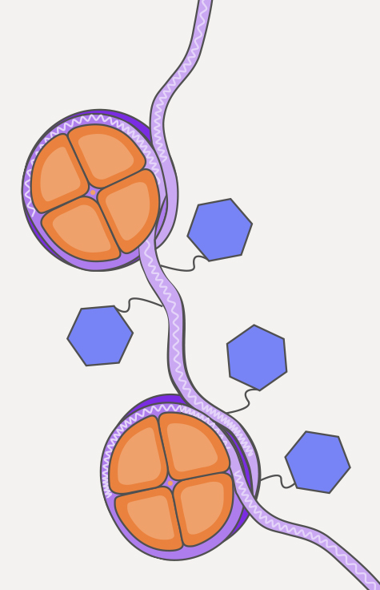

ATAC seq
Team #1

Slide 2
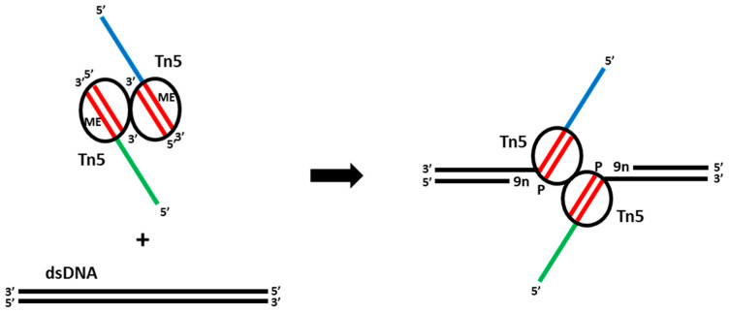
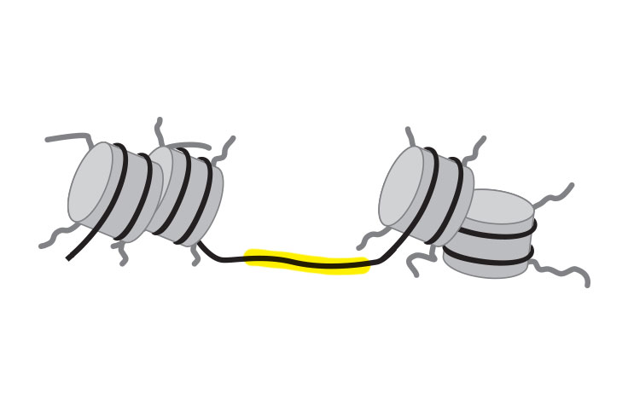
Assay for transposase-accessible chromatin with sequencing
Chromatin accessibility
Tn5 transposase
emea.illumina.com
Penkov, D., Zubkova, E., & Parfyonova, Y. (2023).

Slide 3

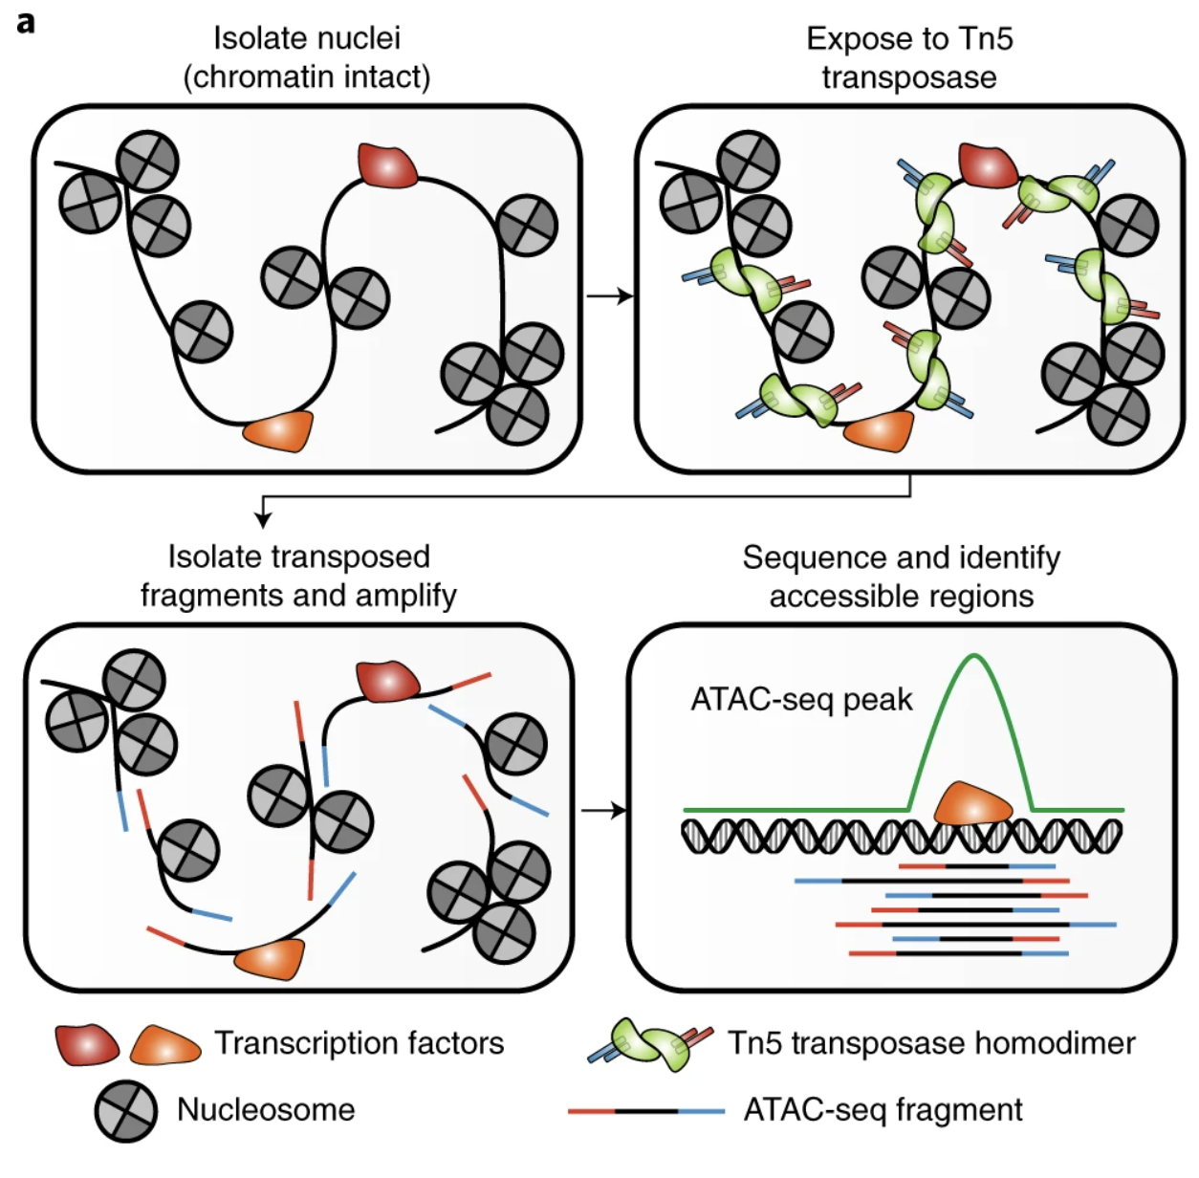
Schematic of the ATAC-seq transposition reaction and library preparation
Nucleic isolation
01
Grandi, F. C., Modi, H., Kampman, L., & Corces, M. R. (2022).

Slide 4
Schematic of the ATAC-seq transposition reaction and library preparation
Nucleic isolation
01
Tn5 insert indexes
02
Grandi, F. C., Modi, H., Kampman, L., & Corces, M. R. (2022).
Notes:
Tn5 will nick any available DNA (euchromatin). Tn5 is previously prepared with the i7 and i5 indexes, which are necessary when preparing strand-sensitive libraries

Slide 5
Schematic of the ATAC-seq transposition reaction and library preparation
Nucleic isolation
01
Tn5 insert indexes
02
Library preparation
03
Grandi, F. C., Modi, H., Kampman, L., & Corces, M. R. (2022).
Notes:
Buenrostro, J. D., Giresi, P. G., Zaba, L. C., Chang, H. Y., & Greenleaf, W. J. (2013).

Slide 6
Schematic of the ATAC-seq transposition reaction and library preparation
Nucleic isolation
01
Tn5 insert indexes
02
Library preparation
01
ATAC-seq analysis
02
Grandi, F. C., Modi, H., Kampman, L., & Corces, M. R. (2022).

Slide 7
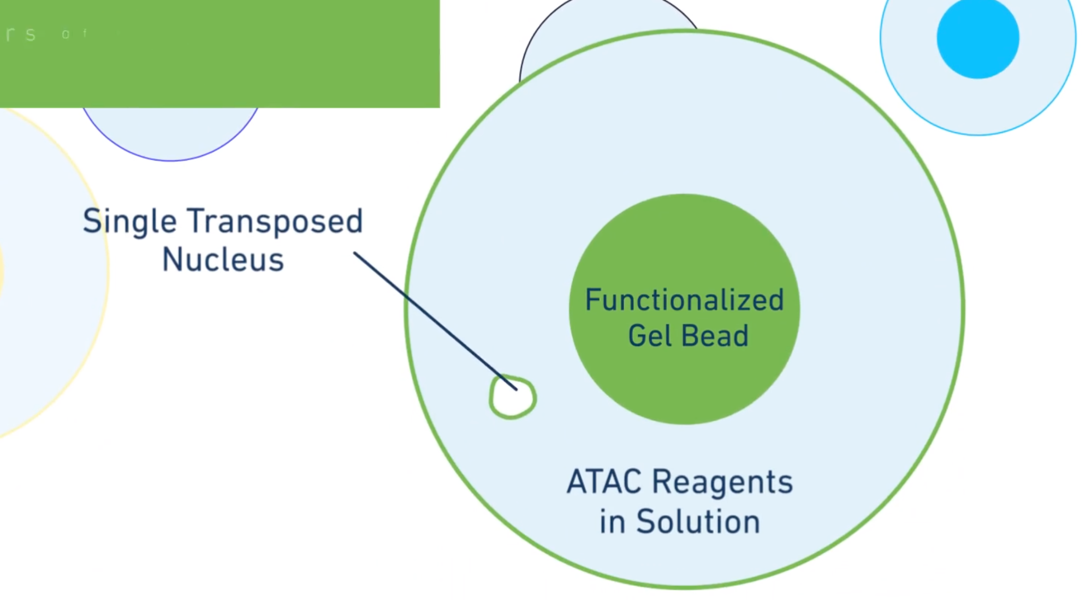
scATAC-seq
Single nucleus are uniquely barcoded after Tn5 reaction
Single nuclei are isolated
DNA from one nucleus share 10x barcode
Reads from single nuclei and per sample
https://www.10xgenomics.com/products/single-cell-atac

Slide 8
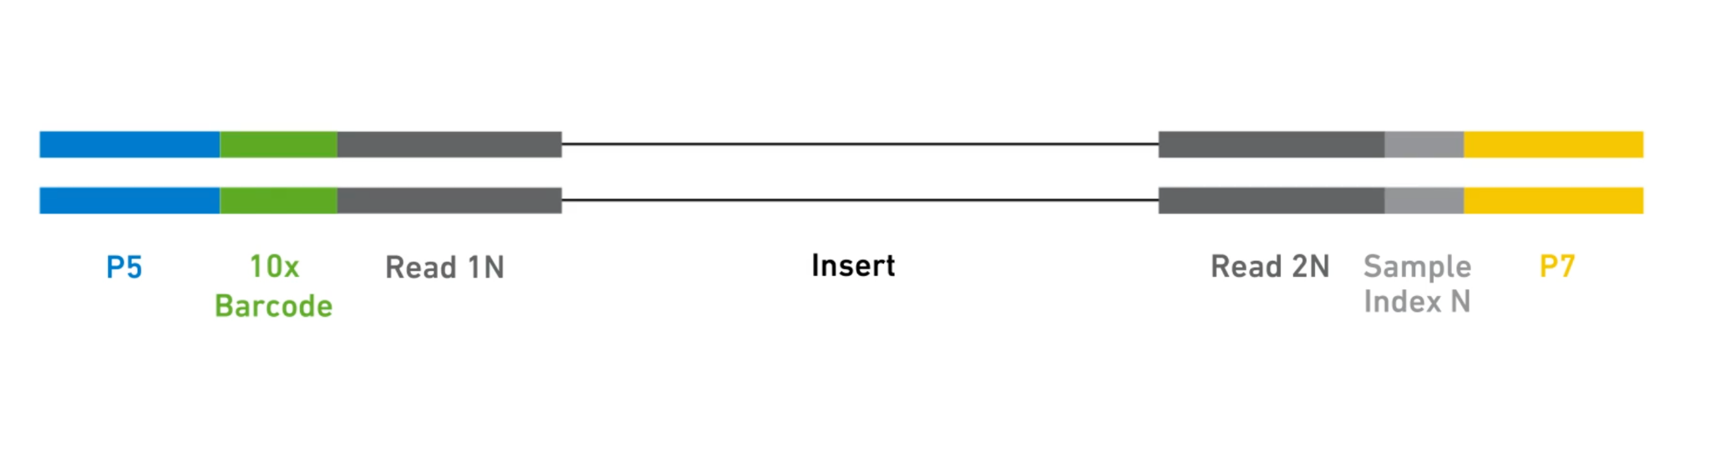
scATAC-seq
Single nucleus are uniquely barcoded after Tn5 reaction
Single nuclei are isolated
DNA from one nucleus share 10x barcode
Reads from single nuclei and per sample
https://www.10xgenomics.com/products/single-cell-atac

Slide 9
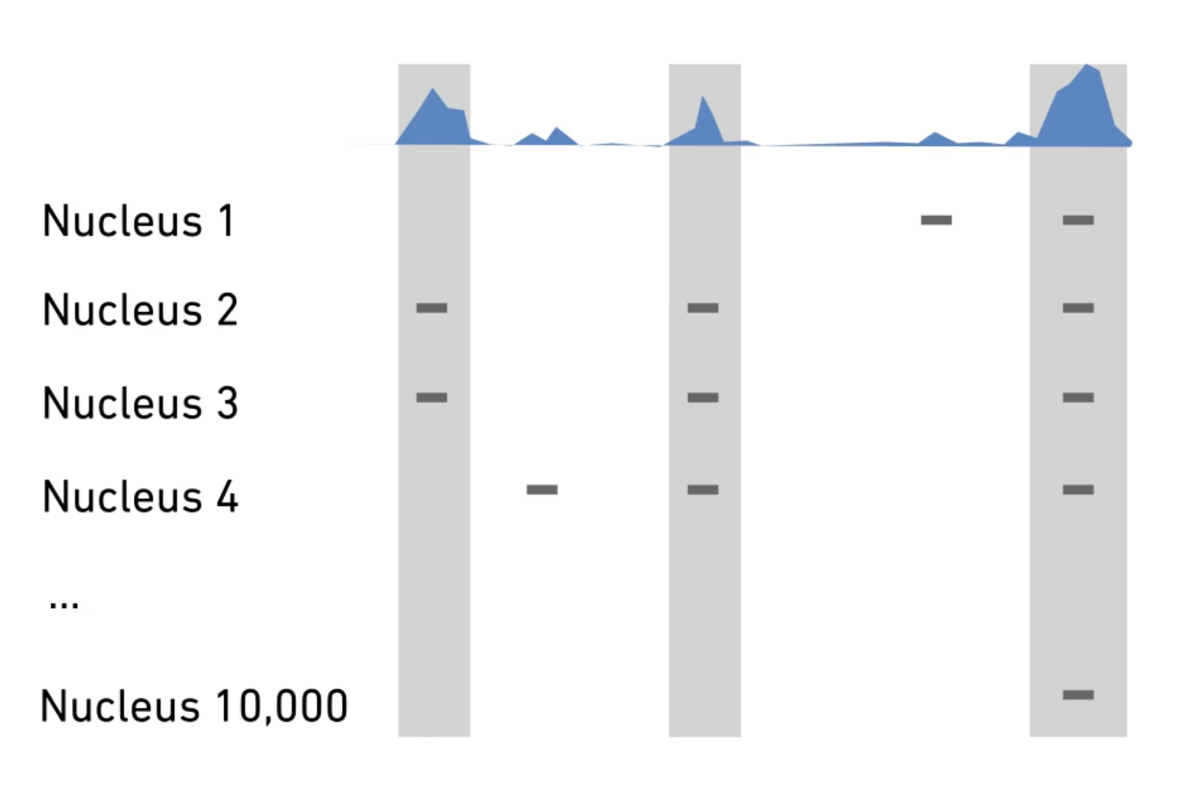
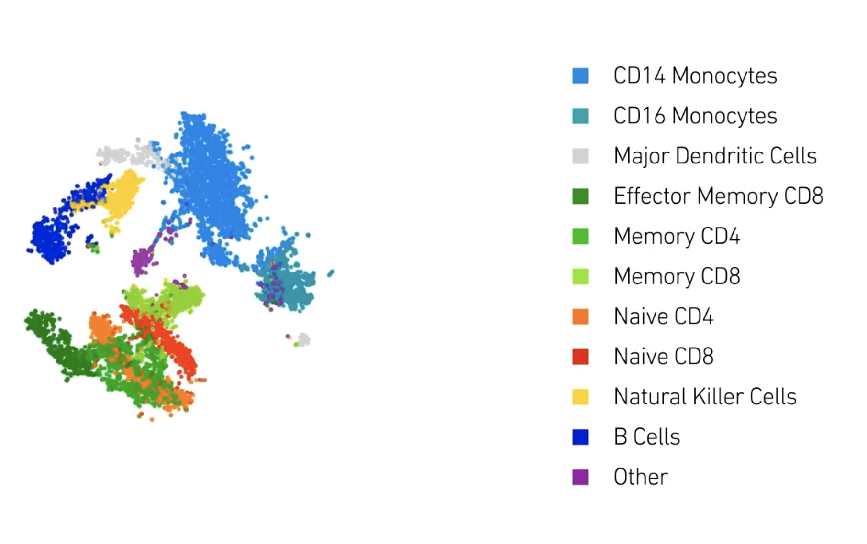
scATAC-seq
Single nucleus are uniquely barcoded after Tn5 reaction
Single nuclei are isolated
DNA from one nucleus share 10x barcode
Reads from single nuclei and per sample
https://www.10xgenomics.com/products/single-cell-atac

Slide 10
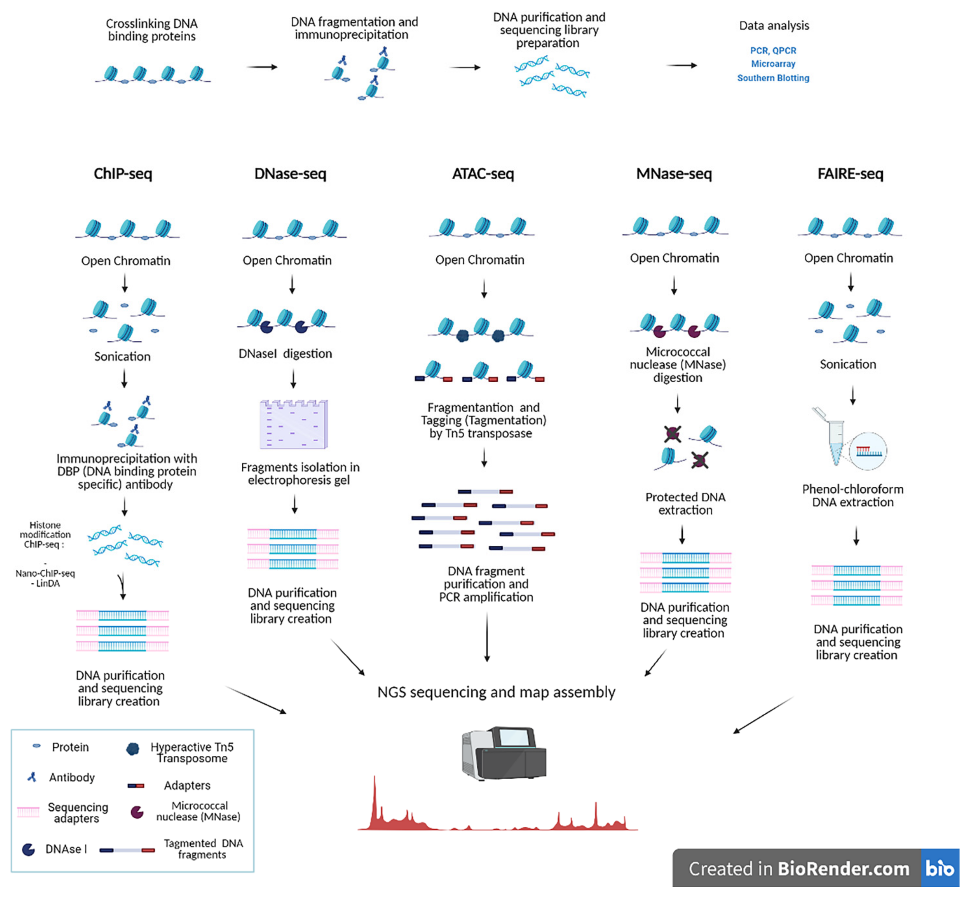
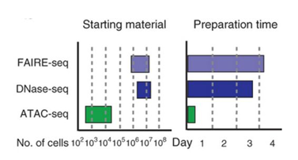
Why ATAC-Seq?
Immuno-ppt
No Immuno-ppt
Latest: OMNI-ATAC-seq
Easy Peasy Two-step protocol
○ Insertion of Tn5 transposase with adaptors
○ PCR amplification
Require less starting material, time and is more accurate.
The sensitivity and specificity is better i.e (signal/noise ratio).
Leo, L., & Colonna Romano, N. (2021)
JD Buenrostro et al, Nature Methods, 2013.

Slide 11
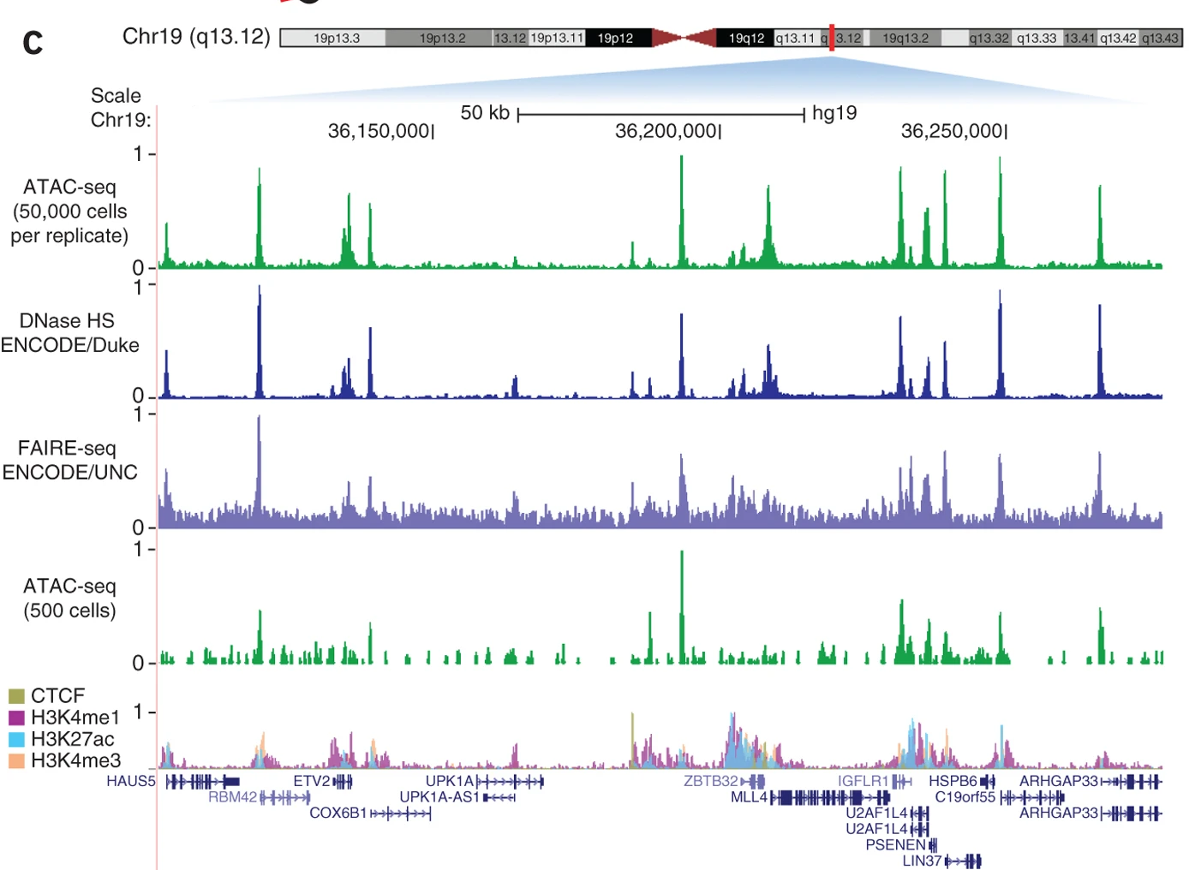
ATAC-seq has a signal-to-noise ratio similar to that of DNase-seq
JD Buenrostro et al, Nature Methods, 2013.

Slide 12

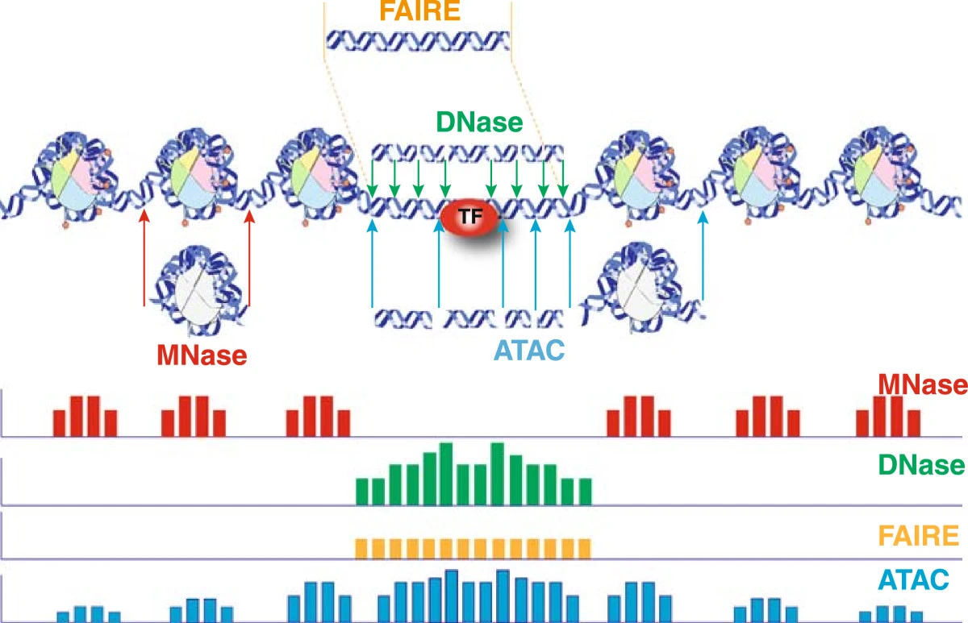
What are we sequencing: A comparison with other techniques
Can identify accessible locations and nucleosome positioning simultaneously (nucleosomes genome-wide is limited to regions in close proximity to accessible sites)
1978
1970s
Indirect accessibility estimation
Direct accessibility estimation
Tsompana, M., & Buck, M. J. (2014)

Slide 13
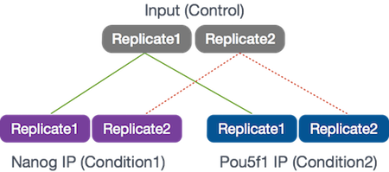
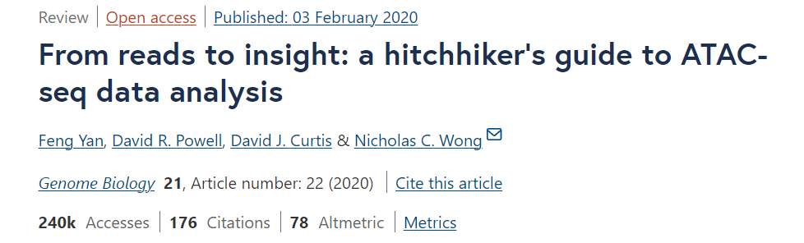
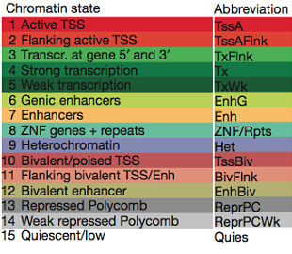
Questions answered using ATAC-Seq
What are open spaces (chromatin accessibility) where the TF sits throughout the genome and what are the genes it influences.
Differential binding sites: Eg: There are 2 transcription factors that are involved in stem cell pluripotency and one of the goals is to understand their roles, individually and together, in transcriptional regulation.
Motifs where TF shows preferential binding.
Nucleosome positioning
Enriched Chromatin States (CHROMHMM and CoRE-ATAC)
Control Absent in ATAC-Seq

Slide 14
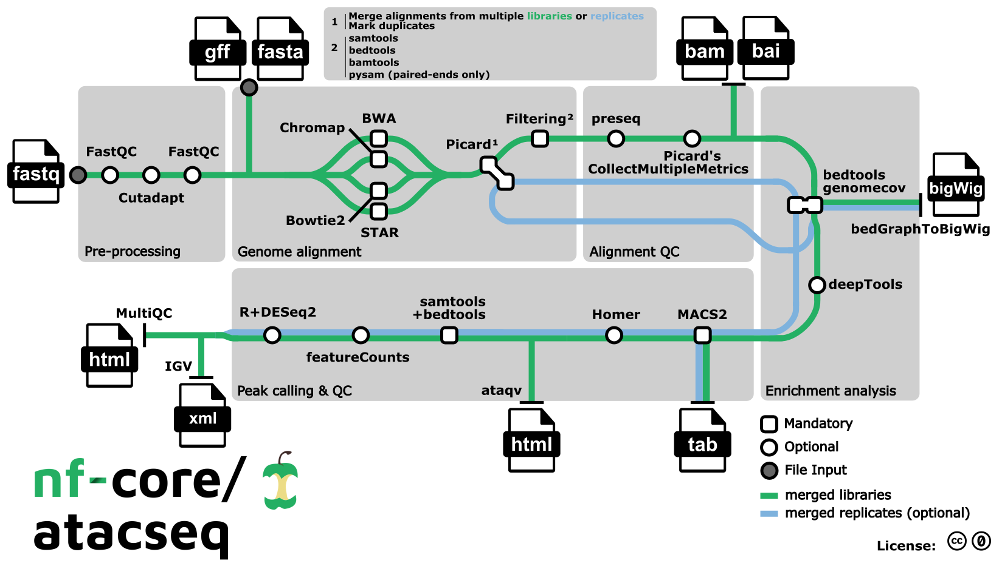
ATAC-Seq data analysis at glance
Merge alignments from multiple libraries of the same sample
Alignment-level QC and estimation of library complexity
Raw read QC, Adapter trimming
Create normalised bigWig files scaled to 1 million mapped read
Mark duplicates
Create IGV session file containing bigWig tracks, peaks and differential sites for data visualisation
QC html report
Call broad/narrow peaks

Slide 15
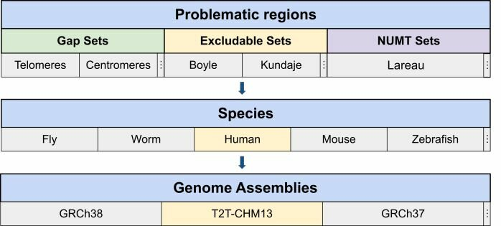

Don’t forget: Take care of artifacts
Blacklisted regions are genomic regions with anomalous, unstructured, high signal or read counts in NGS experiments, independent of cell type or experiment.
These regions are often found at repetitive regions (Centromeres, Telomeres, Satellite repeats) and are troublesome for high throughput sequencing aligners and when computing genome wide correlations.
These regions also confuse peak callers and result in spurious signal.
Various Blacklists are available
ENCODE Data Analysis Center (DAC) blacklisted regions
The Duke Excluded Regions
An extended blacklist is needed for ATAC-seq (Latest and combines all the resources).

Slide 16
Some important links
https://nbis-workshop-epigenomics.readthedocs.io/en/latest/content/tutorials/ATACseq/lab-atacseq-bulk.html#peak-calling
https://genomebiology.biomedcentral.com/articles/10.1186/s13059-020-1929-3
https://www.sciencedirect.com/science/article/pii/S2667237522002119
https://academic.oup.com/nar/article/46/18/9414/5054866?login=true
https://bioinformatics-core-shared-training.github.io/cruk-autumn-school-2017/ChIP/Materials/Lectures/Lecture4_Introduction%20to%20ChIP-seq%20and%20ATAC-seq_SS.pdf
https://www.biorxiv.org/content/10.1101/2020.06.22.165183v2.full

